Slide 1
Learning
Rachel Cavill

Slide 2
Recap: Agent types
Four basic types in order of increasing generality:
Simple reflex agents
Model-based reflex agents
Goal-based agents
Utility-based agents
All can be turned into learning agents

Slide 3
Learning agents
All previous agent‐programs describe methods for selecting actions
It does not explain the origin of these programs
Learning mechanisms can be used to perform this task
Teach them instead of instructing them
i.e., expose the agent to reality rather than trying to write it down
Advantage is the robustness of the program toward initially unknown environments
i.e., when designer lacks omniscience

Slide 4
Learning Agents
Performance element: selecting actions based on percepts
– Corresponds to the previous agent programs
Learning element: introduce improvements in performance element
Critic provides feedback on agents performance based on fixed performance standard
Problem generator: suggests actions that will lead to new and informative experiences
Exploration vs. exploitation

Slide 5
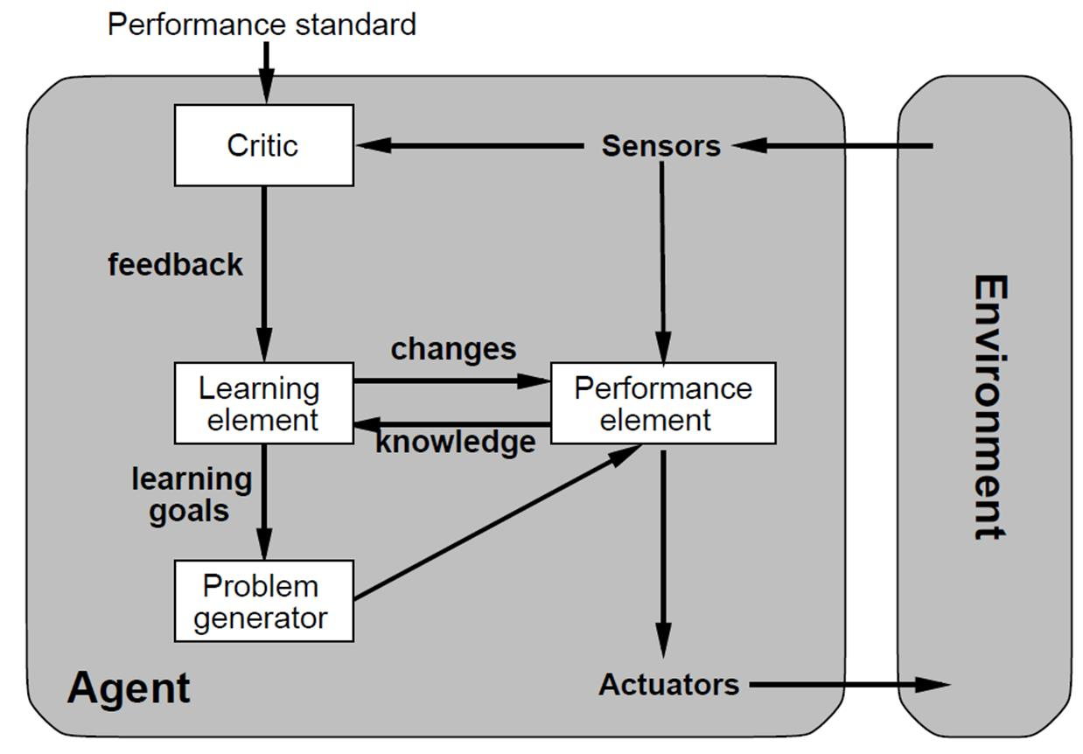
Learning agents

Slide 6
Learning element
Design of a learning element is affected by
Which components of the performance element are to be learned
What feedback is available to learn these components
What representation is used for the components
Type of feedback:
Supervised learning: correct answers for each example
Unsupervised learning: correct answers not given
Reinforcement learning: occasional rewards

Slide 7
Decision Trees
Want a fast meal?
Yes
No
How about coffee?
On expense account?
Yes
No
Yes
No
Starbucks
Spike’s
Al Forno
Café Paragon

Slide 8
Decision Trees: Game AI
Is enemy visible?
Yes
No
Is enemy 10 < m away?
Is enemy audible?
Yes
No
Yes
No
Attack
Is enemy on flank?
Creep
Move
Yes
No
Move
Attack

Slide 9
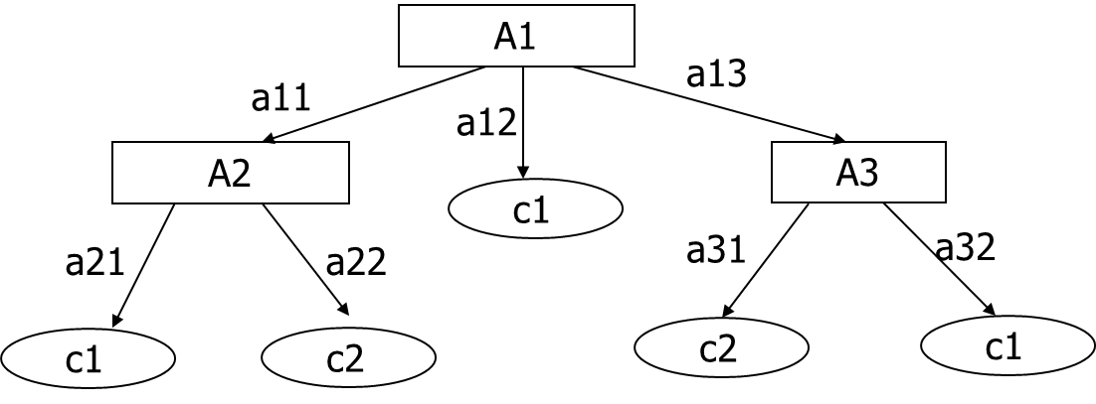
Decision Trees for Classification
A decision tree is a tree where:
Each internal node tests an attribute
Each branch corresponds to an attribute value
Each leaf node is labelled with a class (class node)

Slide 10
A simple database: play tennis
Day | Outlook | Temperature | Humidity | Wind | Play Tennis
D1 | Sunny | Hot | High | Weak | No
D2 | Sunny | Hot | High | Strong | No
D3 | Overcast | Hot | High | Weak | Yes
D4 | Rain | Mild | Normal | Weak | Yes
D5 | Rain | Cool | Normal | Weak | Yes
D6 | Rain | Cool | Normal | Strong | No
D7 | Overcast | Cool | High | Strong | Yes
D8 | Sunny | Mild | Normal | Weak | No
D9 | Sunny | Hot | Normal | Weak | Yes
D10 | Rain | Mild | Normal | Strong | Yes
D11 | Sunny | Cool | Normal | Strong | Yes
D12 | Overcast | Mild | High | Strong | Yes
D13 | Overcast | Hot | Normal | Weak | Yes
D14 | Rain | Mild | High | Strong | No

Slide 11
Decision Tree For Playing Tennis
Outlook
sunny
overcast
rainy
Humidity
yes
Windy
high
normal
weak
strong
no
yes
yes
no

Slide 12
Classification with Decision Trees
Day 15: [rainy, strong]
Outlook
sunny
overcast
rainy
Humidity
yes
Windy
high
normal
weak
strong
no
yes
yes
no

Slide 13
When to Consider Decision Trees
Each instance consists of an attribute with discrete values (e.g. outlook/sunny, etc..)
The classification is over discrete values (e.g. yes/no )
It is okay for the training data to contain errors – depending on the learning algorithm decision trees can be robust to classification errors in the training data.
It is okay for the training data to contain missing values – decision trees can be used even if instances have missing attributes

Slide 14
Decision Tree Learning
Basic Algorithm:
1. A ← the “best" decision attribute for a node N.
2. Assign A as decision attribute for the node N.
3. For each value of A, create new child of node N.
4. Sort training examples to leaf nodes.
5. IF training examples perfectly classified, THEN STOP.
ELSE iterate over new leaf nodes

Slide 15
Decision Tree Learning
Outlook
Sunny
Rain
Overcast
____________________________________
Outlook Temp Hum Wind Play
-------------------------------------------------------
Sunny Hot High Weak No
Sunny Hot High Strong No
Sunny Mild High Weak No
Sunny Cool Normal Weak Yes
Sunny Mild Normal Strong Yes
_____________________________________
Outlook Temp Hum Wind Play
---------------------------------------------------------
Overcast Hot High Weak Yes
Overcast Cool Normal Strong Yes
_____________________________________
Outlook Temp Hum Wind Play
---------------------------------------------------------
Rain Mild High Weak Yes
Rain Cool Normal Weak Yes
Rain Cool Normal Strong No
Rain Mild Normal Weak Yes
Rain Mild High Strong No

Slide 16
Entropy
Let S be a sample of training examples, and p+ is the proportion of positive examples in S and p- is the proportion of negative examples in S.
Then: entropy measures the impurity of S:
E(S) = -p⁺ log₂ p⁺ – p⁻ log₂ p⁻

Slide 17
Entropy with n classes
So for 2 classes we have;
E(S) = -p⁺ log₂ p⁺ – p⁻ log₂ p⁻
But if we have more than 2 classes, this formula won’t work anymore.
We could extend it with;
E(S) = -p¹ log₂ p¹ – p² log₂ p² – p³ log₂ p³
But now if we have 5, 3 and 2 in each class we will get
-0.5log₂ 0.5 – 0.3log₂0.3 – 0.2log₂0.2 = 1.49
Breaks the idea that entropy is between 0 and 1
To fix use log₃ for 3 classes and log_{n} for n classes

Slide 18
Intermezzo: Logarithms
Properties of logarithms
log_{b}a = c if a = b^{c}
log_{b}(a●c) = log_{b}a + log_{b}c ;
log_{b} (a/c) = log_{b}a – log_{b}c
log_{b}a = (log_{c}a) / (log_{c}b)
So:
Log₁₀(100) = 2; log₁₀(1) = 0, log₁₀(0.001)=-3
log₂(0.5) = -1; log₂(8) = 3; log₂(0.25) = -2
log₂(0.4)= ln(0.4)/ln(2)=(or log₁₀(0.4) / log₁₀(2)) ≈ -1.32

Slide 19
Entropy Example from the Dataset
In the Play Tennis dataset we had two target classes: yes and no
Out of 14 instances, 9 classified yes, rest no
Outlook | Temp. | Humidity | Windy | Play
Sunny | Hot | High | False | No
Sunny | Hot | High | True | No
Overcast | Hot | High | False | Yes
Rainy | Mild | High | False | Yes
Rainy | Cool | Normal | False | Yes
Rainy | Cool | Normal | True | No
Overcast | Cool | Normal | True | Yes
Outlook | Temp. | Humidity | Windy | play
Sunny | Mild | High | False | No
Sunny | Cool | Normal | False | Yes
Rainy | Mild | Normal | False | Yes
Sunny | Mild | Normal | True | Yes
Overcast | Mild | High | True | Yes
Overcast | Hot | Normal | False | Yes
Rainy | Mild | High | True | No

Slide 20
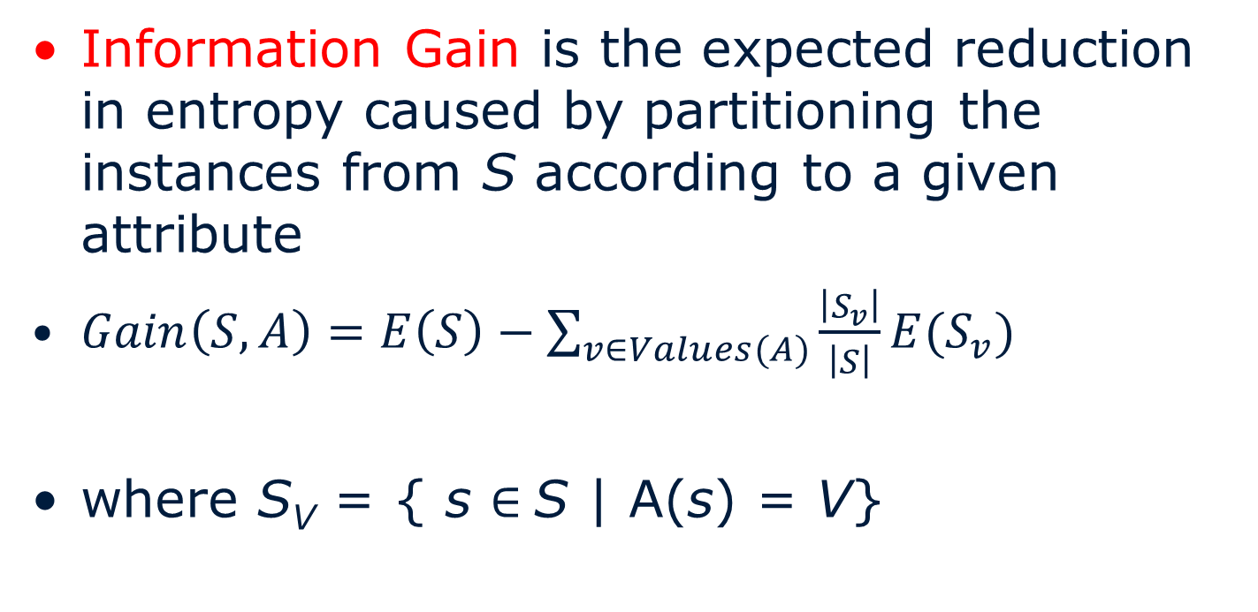
Information Gain
Information Gain is the expected reduction in entropy caused by partitioning the instances from S according to a given attribute
$Gain\left(S,A\right)=E\left(S\right)−\sum_{v∈Values(A)}{\frac{\left|S_{v}\right|}{\left|S\right|}E(S_{v})}$
where S_{V} = { s $∈$S | A(s) = V}

Slide 21
Example
Outlook
Sunny
Rain
Overcast
____________________________________
Outlook Temp Hum Wind Play
-------------------------------------------------------
Sunny Hot High Weak No
Sunny Hot High Strong No
Sunny Mild High Weak No
Sunny Cool Normal Weak Yes
Sunny Mild Normal Strong Yes
_____________________________________
Outlook Temp Hum Wind Play
---------------------------------------------------------
Overcast Hot High Weak Yes
Overcast Cool Normal Strong Yes
_____________________________________
Outlook Temp Hum Wind Play
---------------------------------------------------------
Rain Mild High Weak Yes
Rain Cool Normal Weak Yes
Rain Cool Normal Strong No
Rain Mild Normal Weak Yes
Rain Mild High Strong No
Which attribute should be tested here?

Slide 22
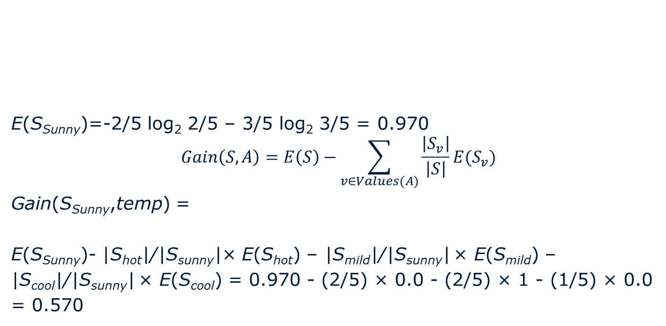
Example: Sunny (Temperature)
____________________________________
Outlook Temp Hum Wind Play
-------------------------------------------------------
Sunny Hot High Weak No
Sunny Hot High Strong No
Sunny Mild High Weak No
Sunny Cool Normal Weak Yes
Sunny Mild Normal Strong Yes
E(S_{Sunny})=-2/5 log₂ 2/5 – 3/5 log₂ 3/5 = 0.970
$$Gain\left(S,A\right)=E\left(S\right)−\sum_{v∈Values(A)}{\frac{\left|S_{v}\right|}{\left|S\right|}E(S_{v})}$$
Gain(S_{Sunny},temp) =
E(S_{Sunny})- |S_{hot}|/|S_{sunny}|× E(S_{hot}) – |S_{mild}|/|S_{sunny}| × E(S_{mild}) –
|S_{cool}|/|S_{sunny}| × E(S_{cool}) = 0.970 - (2/5) × 0.0 - (2/5) × 1 - (1/5) × 0.0
= 0.570

Slide 23
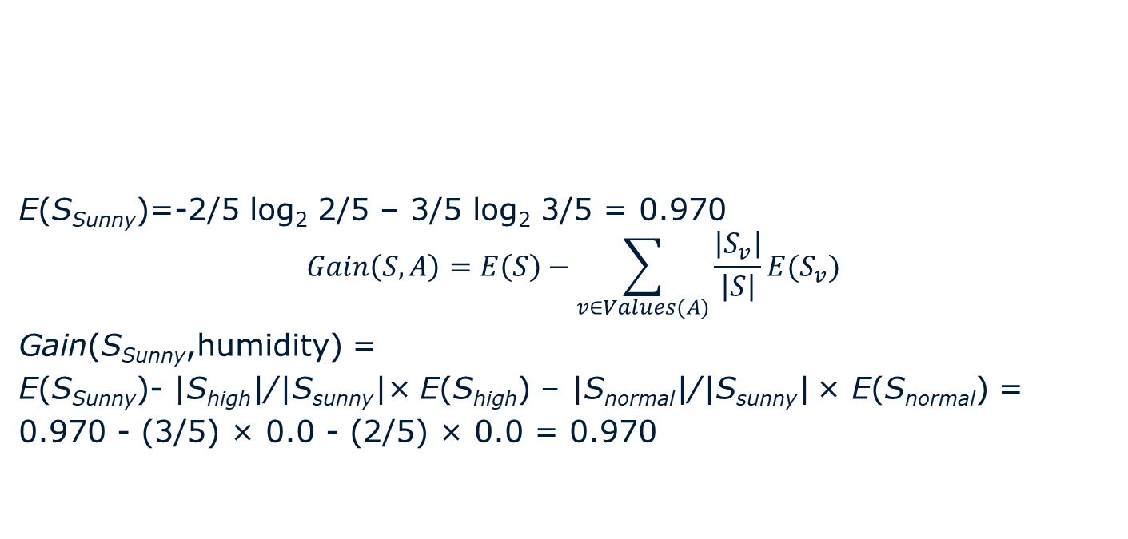
Example: Sunny (humidity)
____________________________________
Outlook Temp Hum Wind Play
-------------------------------------------------------
Sunny Hot High Weak No
Sunny Hot High Strong No
Sunny Mild High Weak No
Sunny Cool Normal Weak Yes
Sunny Mild Normal Strong Yes
E(S_{Sunny})=-2/5 log₂ 2/5 – 3/5 log₂ 3/5 = 0.970
$$Gain\left(S,A\right)=E\left(S\right)−\sum_{v∈Values(A)}{\frac{\left|S_{v}\right|}{\left|S\right|}E(S_{v})}$$
Gain(S_{Sunny},humidity) =
E(S_{Sunny})- |S_{high}|/|S_{sunny}|× E(S_{high}) – |S_{normal}|/|S_{sunny}| × E(S_{normal}) =
0.970 - (3/5) × 0.0 - (2/5) × 0.0 = 0.970

Slide 24
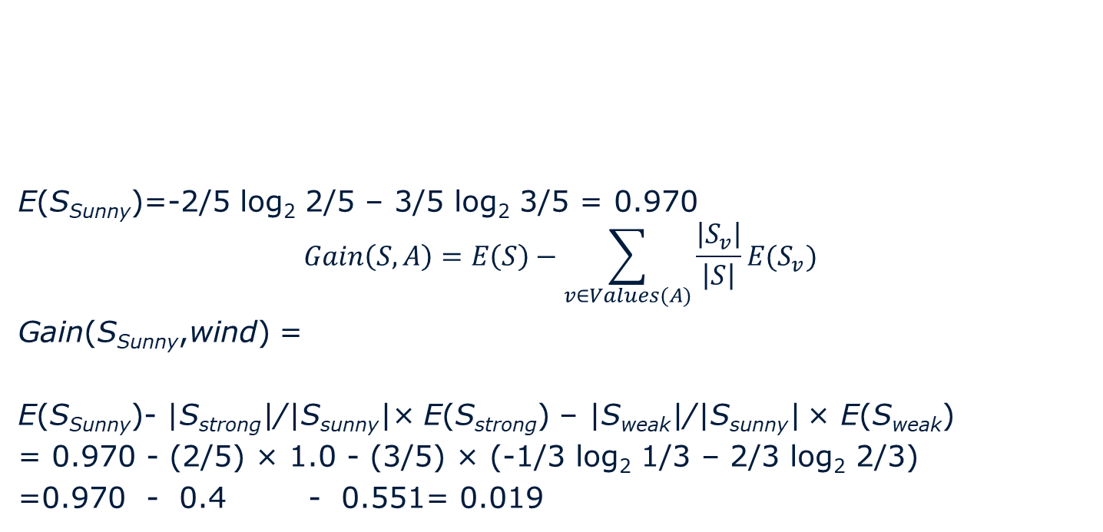
Example: Sunny (Wind)
____________________________________
Outlook Temp Hum Wind Play
-------------------------------------------------------
Sunny Hot High Weak No
Sunny Hot High Strong No
Sunny Mild High Weak No
Sunny Cool Normal Weak Yes
Sunny Mild Normal Strong Yes
E(S_{Sunny})=-2/5 log₂ 2/5 – 3/5 log₂ 3/5 = 0.970
$$Gain\left(S,A\right)=E\left(S\right)−\sum_{v∈Values(A)}{\frac{\left|S_{v}\right|}{\left|S\right|}E(S_{v})}$$
Gain(S_{Sunny},wind) =
E(S_{Sunny})- |S_{strong}|/|S_{sunny}|× E(S_{strong}) – |S_{weak}|/|S_{sunny}| × E(S_{weak})
= 0.970 - (2/5) × 1.0 - (3/5) × (-1/3 log₂ 1/3 – 2/3 log₂ 2/3)
=0.970 - 0.4 - 0.551= 0.019

Slide 25
Example
____________________________________
Outlook Temp Hum Wind Play
-------------------------------------------------------
Sunny Hot High Weak No
Sunny Hot High Strong No
Sunny Mild High Weak No
Sunny Cool Normal Weak Yes
Sunny Mild Normal Strong Yes
Which attribute should be tested here?
Gain(S_{sunny}, Humidity) = .970 - (3/5) 0.0 - (2/5) 0.0 = .970
Gain(S_{sunny},Temp) = .970 - (2/5) 0.0 - (2/5) 1.0 - (1/5) 0.0 = .570
Gain(S_{sunny},Wind) = .970 - (2/5) 1.0 - (3/5) 0.918 = .019

Slide 26
Example
Outlook
Sunny
Rain
Overcast
____________________________________
Outlook Temp Hum Wind Play
-------------------------------------------------------
Sunny Hot High Weak No
Sunny Hot High Strong No
Sunny Mild High Weak No
Sunny Cool Normal Weak Yes
Sunny Mild Normal Strong Yes
_____________________________________
Outlook Temp Hum Wind Play
---------------------------------------------------------
Overcast Hot High Weak Yes
Overcast Cool Normal Strong Yes
_____________________________________
Outlook Temp Hum Wind Play
---------------------------------------------------------
Rain Mild High Weak Yes
Rain Cool Normal Weak Yes
Rain Cool Normal Strong No
Rain Mild Normal Weak Yes
Rain Mild High Strong No
Compute the information gain for each attribute?
Which attribute should be tested here?

Slide 27
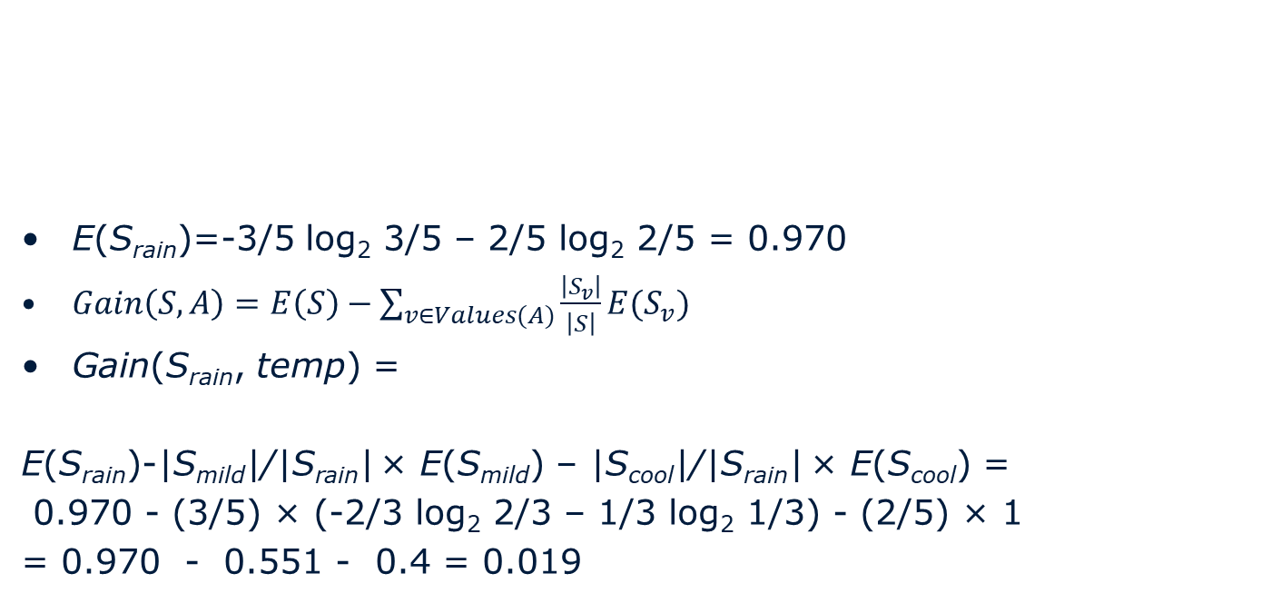
Example: Rain (Temperature)
_____________________________________
Outlook Temp Hum Wind Play
---------------------------------------------------------
Rain Mild High Weak Yes
Rain Cool Normal Weak Yes
Rain Cool Normal Strong No
Rain Mild Normal Weak Yes
Rain Mild High Strong No
E(S_{rain})=-3/5 log₂ 3/5 – 2/5 log₂ 2/5 = 0.970
$Gain\left(S,A\right)=E\left(S\right)−\sum_{v∈Values(A)}{\frac{\left|S_{v}\right|}{\left|S\right|}E(S_{v})}$
Gain(S_{rain}, temp) =
E(S_{rain})-|S_{mild}|/|S_{rain}| × E(S_{mild}) – |S_{cool}|/|S_{rain}| × E(S_{cool}) =
0.970 - (3/5) × (-2/3 log₂ 2/3 – 1/3 log₂ 1/3) - (2/5) × 1
= 0.970 - 0.551 - 0.4 = 0.019

Slide 28
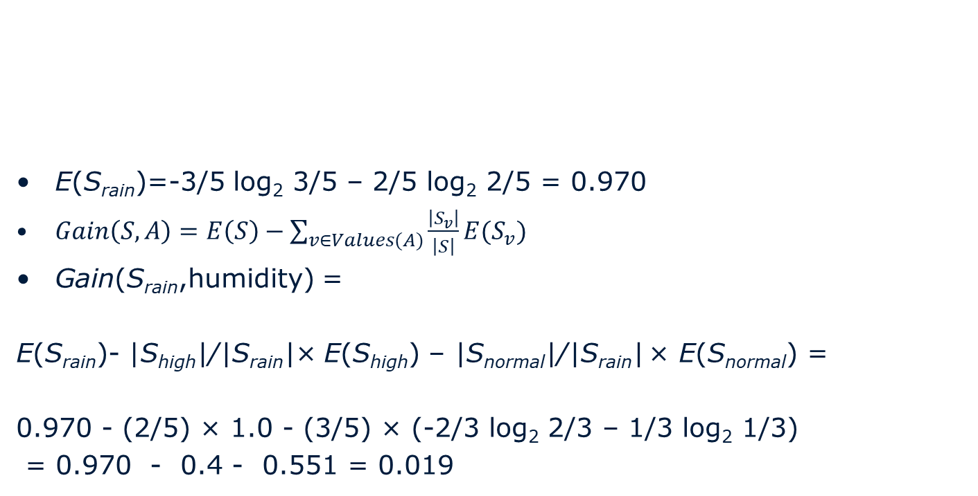
Example: Rain (humidity)
_____________________________________
Outlook Temp Hum Wind Play
---------------------------------------------------------
Rain Mild High Weak Yes
Rain Cool Normal Weak Yes
Rain Cool Normal Strong No
Rain Mild Normal Weak Yes
Rain Mild High Strong No
E(S_{rain})=-3/5 log₂ 3/5 – 2/5 log₂ 2/5 = 0.970
$Gain\left(S,A\right)=E\left(S\right)−\sum_{v∈Values(A)}{\frac{\left|S_{v}\right|}{\left|S\right|}E(S_{v})}$
Gain(S_{rain},humidity) =
E(S_{rain})- |S_{high}|/|S_{rain}|× E(S_{high}) – |S_{normal}|/|S_{rain}| × E(S_{normal}) =
0.970 - (2/5) × 1.0 - (3/5) × (-2/3 log₂ 2/3 – 1/3 log₂ 1/3)
= 0.970 - 0.4 - 0.551 = 0.019

Slide 29
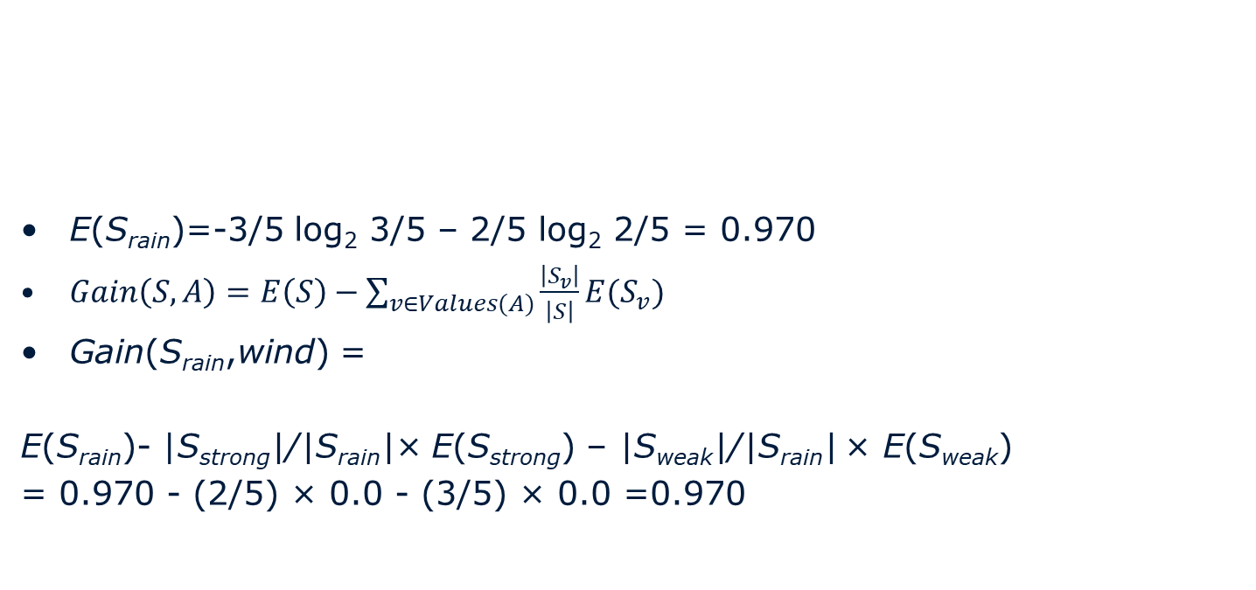
Example: Rain (Wind)
_____________________________________
Outlook Temp Hum Wind Play
---------------------------------------------------------
Rain Mild High Weak Yes
Rain Cool Normal Weak Yes
Rain Cool Normal Strong No
Rain Mild Normal Weak Yes
Rain Mild High Strong No
E(S_{rain})=-3/5 log₂ 3/5 – 2/5 log₂ 2/5 = 0.970
$Gain\left(S,A\right)=E\left(S\right)−\sum_{v∈Values(A)}{\frac{\left|S_{v}\right|}{\left|S\right|}E(S_{v})}$
Gain(S_{rain},wind) =
E(S_{rain})- |S_{strong}|/|S_{rain}|× E(S_{strong}) – |S_{weak}|/|S_{rain}| × E(S_{weak})
= 0.970 - (2/5) × 0.0 - (3/5) × 0.0 =0.970

Slide 30
Example: Rain
_____________________________________
Outlook Temp Hum Wind Play
---------------------------------------------------------
Rain Mild High Weak Yes
Rain Cool Normal Weak Yes
Rain Cool Normal Strong No
Rain Mild Normal Weak Yes
Rain Mild High Strong No
Which attribute should be tested here?
Gain(S_{rain}, temp) = 0.019
Gain(S_{rain},humidity) = 0.019
Gain(S_{rain},wind) =0.970

Slide 31
Decision Tree For Playing Tennis
Outlook
sunny
overcast
rainy
Humidity
yes
Windy
high
normal
weak
strong
no
yes
yes
no

Slide 32
Decision trees with real values
If we want to build a decision tree from numerical variables, we first need to turn that into discrete data.
For decision trees we generally use 2 classes, x > a and x ≤ a.
So for the following data; 1, 1.2, 1.5, 1.8, 1.8, 2
We would look at setting a at 1.1, 1.35, 1.65, 1.9
We would choose using the information gain of each point.

Slide 33
Example
Height | Obese?
1.56m | Y
1.64m | Y
1.64m | N
1.84m | Y
2.02m | N
E(height) = 0.95
Possible splitting points: 1.6m, 1.74m, 1.93m
Splitting point | E(above_split) | E(below_split) | Information gain
1.6m | 1 | 0 | 0.17
1.74m | 1 | 0.912 | 0.02
1.93m | 0 | 0.811 | 0.32

Slide 34
ID3 Algorithm
Informally:
Determine the attribute with the highest information gain on the training set
Use this attribute as the root, create a branch for each of the values the attribute can have
For each branch, repeat the process with subset of the training set that is classified by that branch

Slide 35
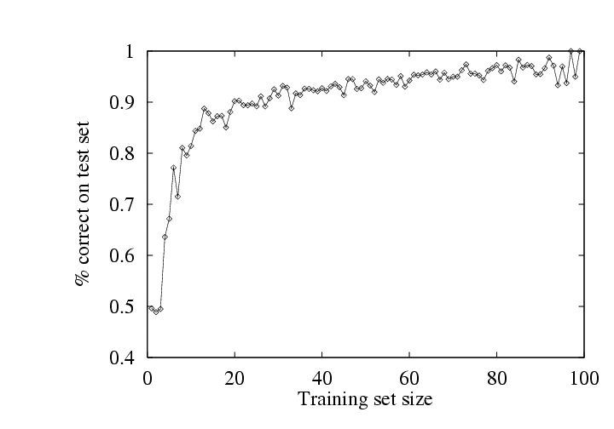
Performance measurement
Try h on a new test set of examples
(use same distribution over example space as training set)
Learning curve = % correct on test set as a function of training set size

Slide 36
What about learning performance on the training set?
The training set only tells us about what the algorithm ‘remembers’ from data it has already seen
The best estimate of how our classifier will perform in future is to have an independent test set and evaluate it on that.

Slide 37
Summary
Learning needed for unknown environments, lazy designers
Learning agent = performance element + learning element
Decision tree learning using information gain
Learning performance = prediction accuracy measured on test set

Slide 38
Exam checklist
How to adjust an agent to turn it into a learning agent (theory)
Calculating logs in all bases on a calculator with only log₁₀ and ln
Calculating entropy
Calculating information gain
Building a decision tree by hand
Turning real valued data into discrete classes
The importance of a test set when learning.

Slide 39
Learning at DACS
Machine Learning
Data Analysis
Data Mining
Advanced Concepts in Machine Learning
Statistics is necessary competence!

Slide 40
Reading
2.4.6 & 18.3

